Slide 1

Ruby Object Composition

Slide 2
Learn at least one new language every year.
Notes:
In chapter one of The Pragmatic Programmer, this is the first learning goal. So why are we introducing a second so early? For reasons.

Slide 3
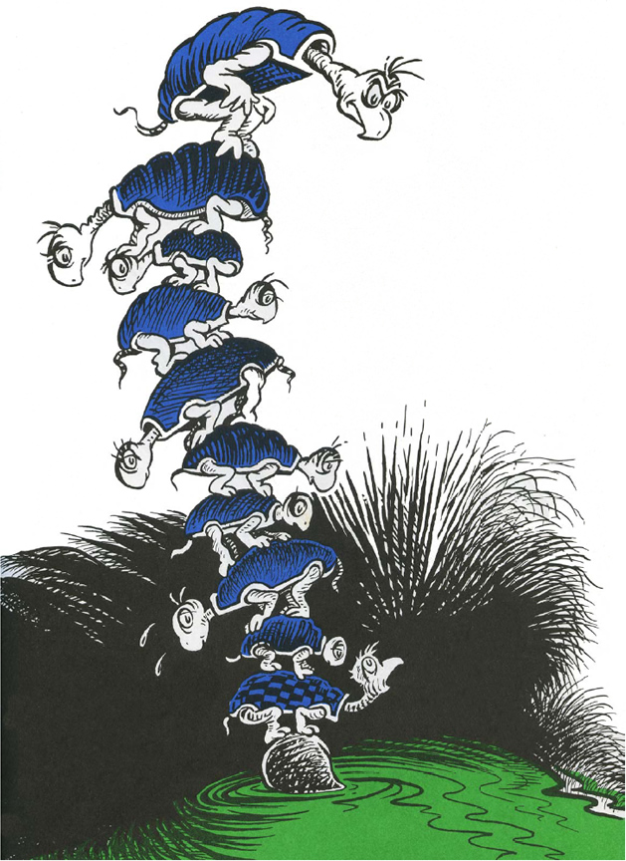
Let’s
talk
about
our
stack

Slide 4



We
need
to
go
deeper

Slide 5
Objects: A Review

Slide 6
Data
Logic
Objects

Slide 7
Ruby Objects are made of Ruby Classes.
Classes provide an Initializer method, which allows us to set up our initial State. Arguments passed in to initialize will be saved as Instance Variables.
class Human def initialize(first_name, last_name) @first_name = first_name @last_name = last_name end def full_name "#{@first_name} #{@last_name}" end def greeting "Hello, my name is #{full_name}!" end end
You can then use those Instance Variables inside of Instance Methods. You can even call instance methods inside of other instance methods.

Slide 8

character =
Snowman.new("Olaf")
character.greeting
“Hi, everyone. I'm Olaf and I like warm hugs!”

Slide 9

Shall we play a game?
A strange game. The only winning move is not to play.

Slide 10
Getters & Setters
attr_accessor, attr_reader, attr_writer

Slide 11
Object Oriented Modeling
Identify what the classes are in your system
Identify the attributes of those classes
Identify the operations those classes perform
Identify the relationships between classes

Slide 12
Some (very preliminary) OOP Best Practices

Slide 13
[A] computer language is… a novel formal medium for expressing ideas about methodology. Thus, programs must be written for people to read, and only incidentally for machines to execute.
Notes:
Hal Abelson's, Jerry Sussman's & Julie Sussman's “Structure and Interpretation of Computer Programs” aka “the Wizard Book”.

Slide 14

“And the world’s gonna know your name – what’s your name, man?”

Slide 15
Single Responsibility Principle
Each class should have a single responsibility
“Do the smallest possible useful thing”
Similarly, keep your class a reasonable length!
Roughly, try not to exceed 100 lines or 5 methods

Slide 16
Encapsulation
Define and name details and data in your class
Provide a simple and clean “interface” for other classes to interact with this one
(“Interface” refers to the ways in which other code is allowed to interact with this class. I.e., the methods you make public.)

Slide 17
In Review
In general, OOP allows you to:
Break a problem down into small chunks (“decomposition”)
Clearly separate and organize those chunks (“encapsulation”)
Make nice interfaces for one piece of code to interact with another (without worrying about unrelated implementation details!)

Slide 18
There’s still
so much more!
For awesome best practices, go read: Practical Object Oriented Design in Ruby
(aka “Poodr”)
by Sandi Metz

